Slide 1
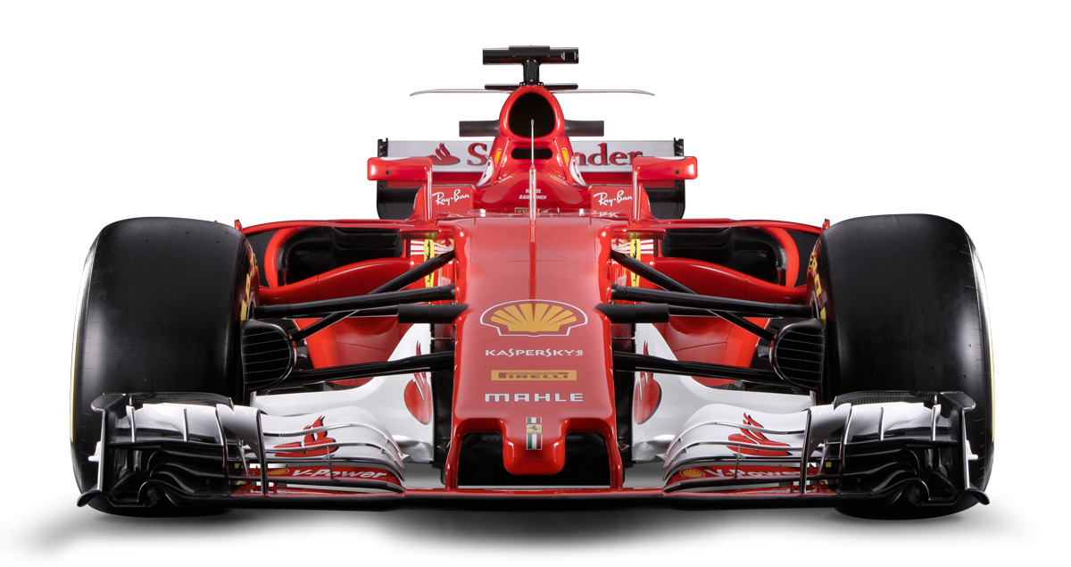
Design and Development of a Web Based Formula One Historical Data and Replay System
Benjamin Gilchrist
F538783
MSc Computer Science

Slide 2
Motivation
Formula One produces A LOT of data!
But accessing it is limited…
Few good ways to access this data
Existing methods are limited/confusing
Payment is sometimes required

Slide 3
Aim
Make a site that makes Formula One data accessible to casual viewers, with enough depth for enthusiasts

Slide 4
Key Functionality
View historic results from current and previous seasons
View breakdowns from every session of a weekend
Replay historic sessions which includes:
  Mini-Map
  Timing Tower

Slide 5
User Journey
Select a season and race weekend
View a summary of each session
Select a session and view full results
View a replay of selected session

Slide 6
Frontend & Development
Frontend
Development Tools
HTML
CSS
JavaScript
VS Code
GitHub
Browser Application

Slide 7
Open F1 API
Features:
Historic Data (2023-2026)
Data streaming for live sessions
API Routes:
REST API
MQTT Websocket
Access a variety of information:
Driver
Race Control
Weather
Interval Gap/Leader Gap
Most Importantly:
  Session
  Meeting
Data Route:
Formula One Open F1 My Frontend User

Slide 8
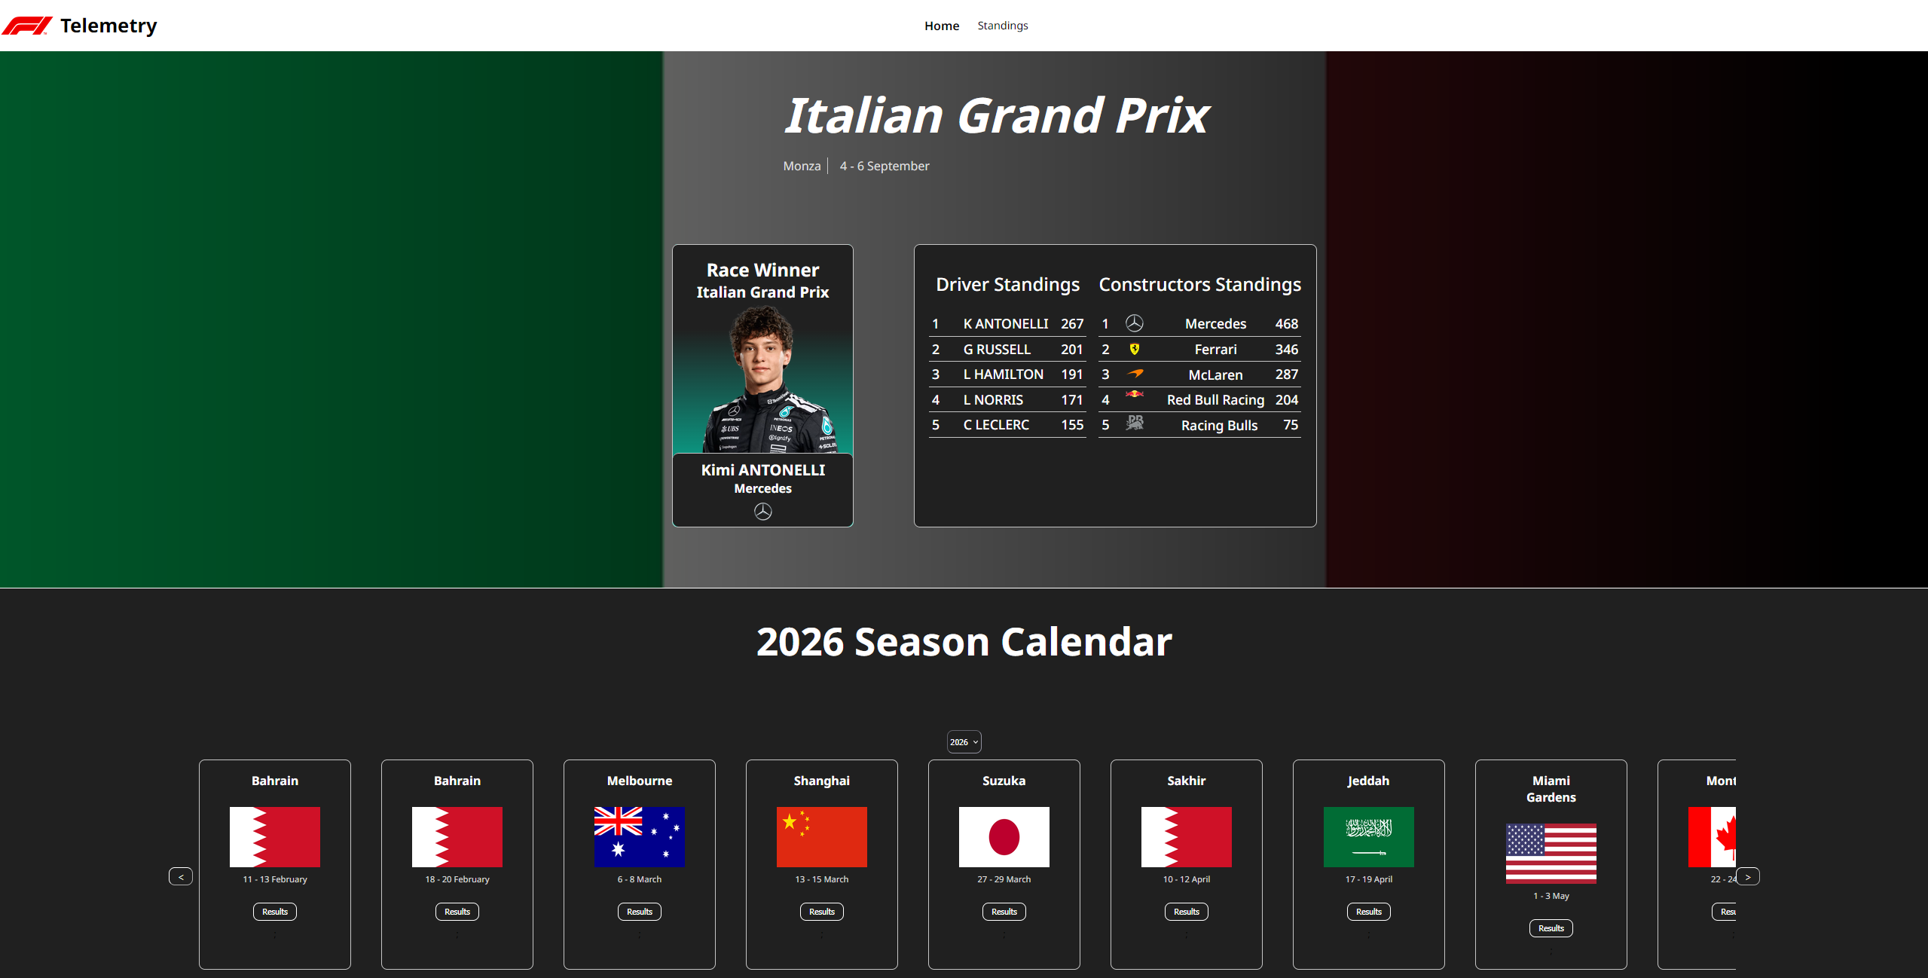
Historical Data
Summary of the previous race
Select a season
View the calendar
Select a race weekend

Slide 9
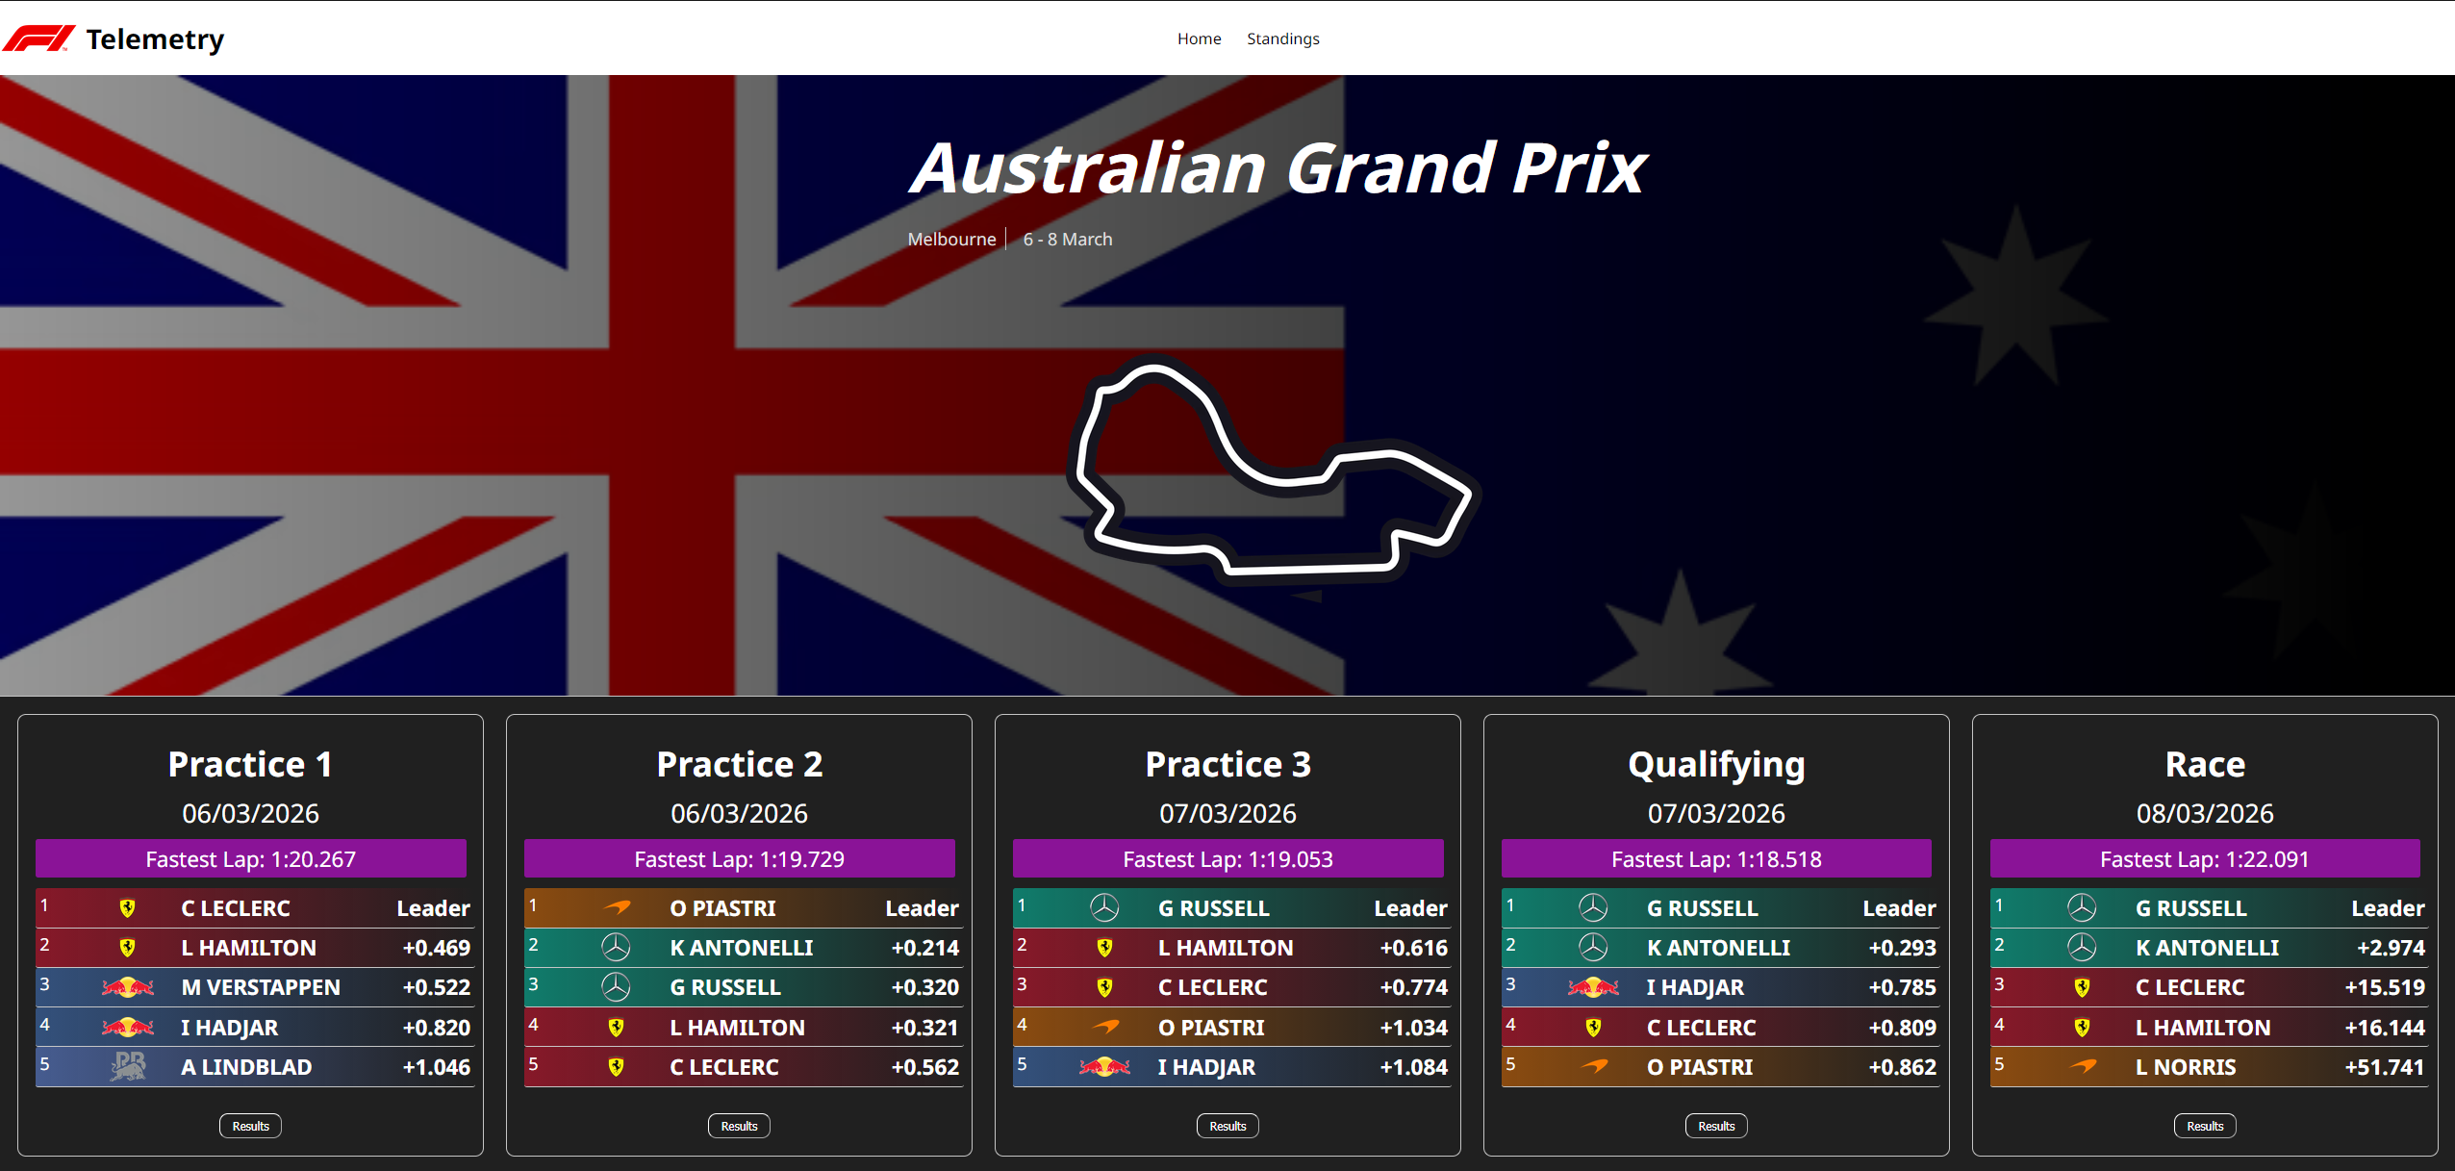
Weekend Summary
View top 5 of each session
Brief information summary of the session

Slide 10
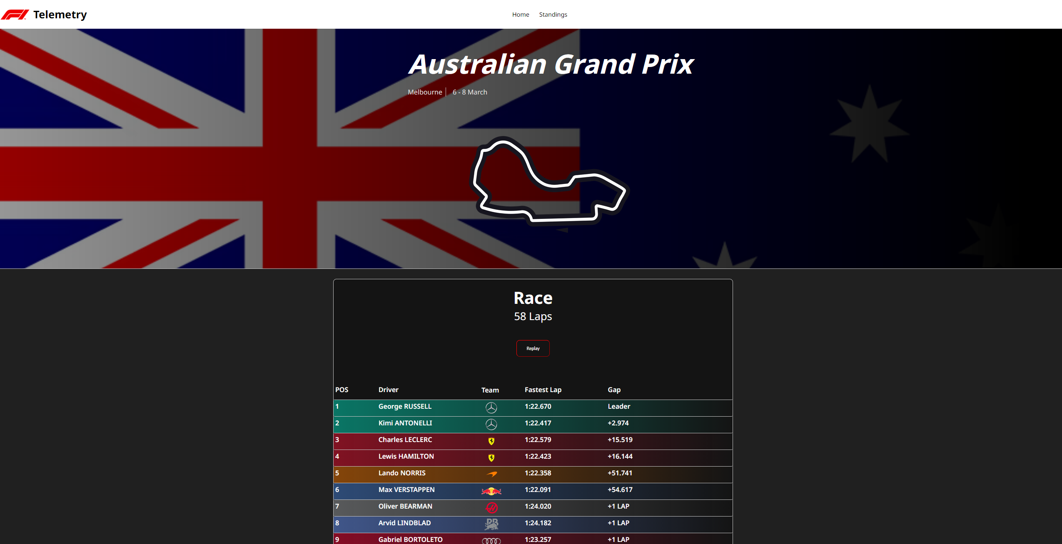
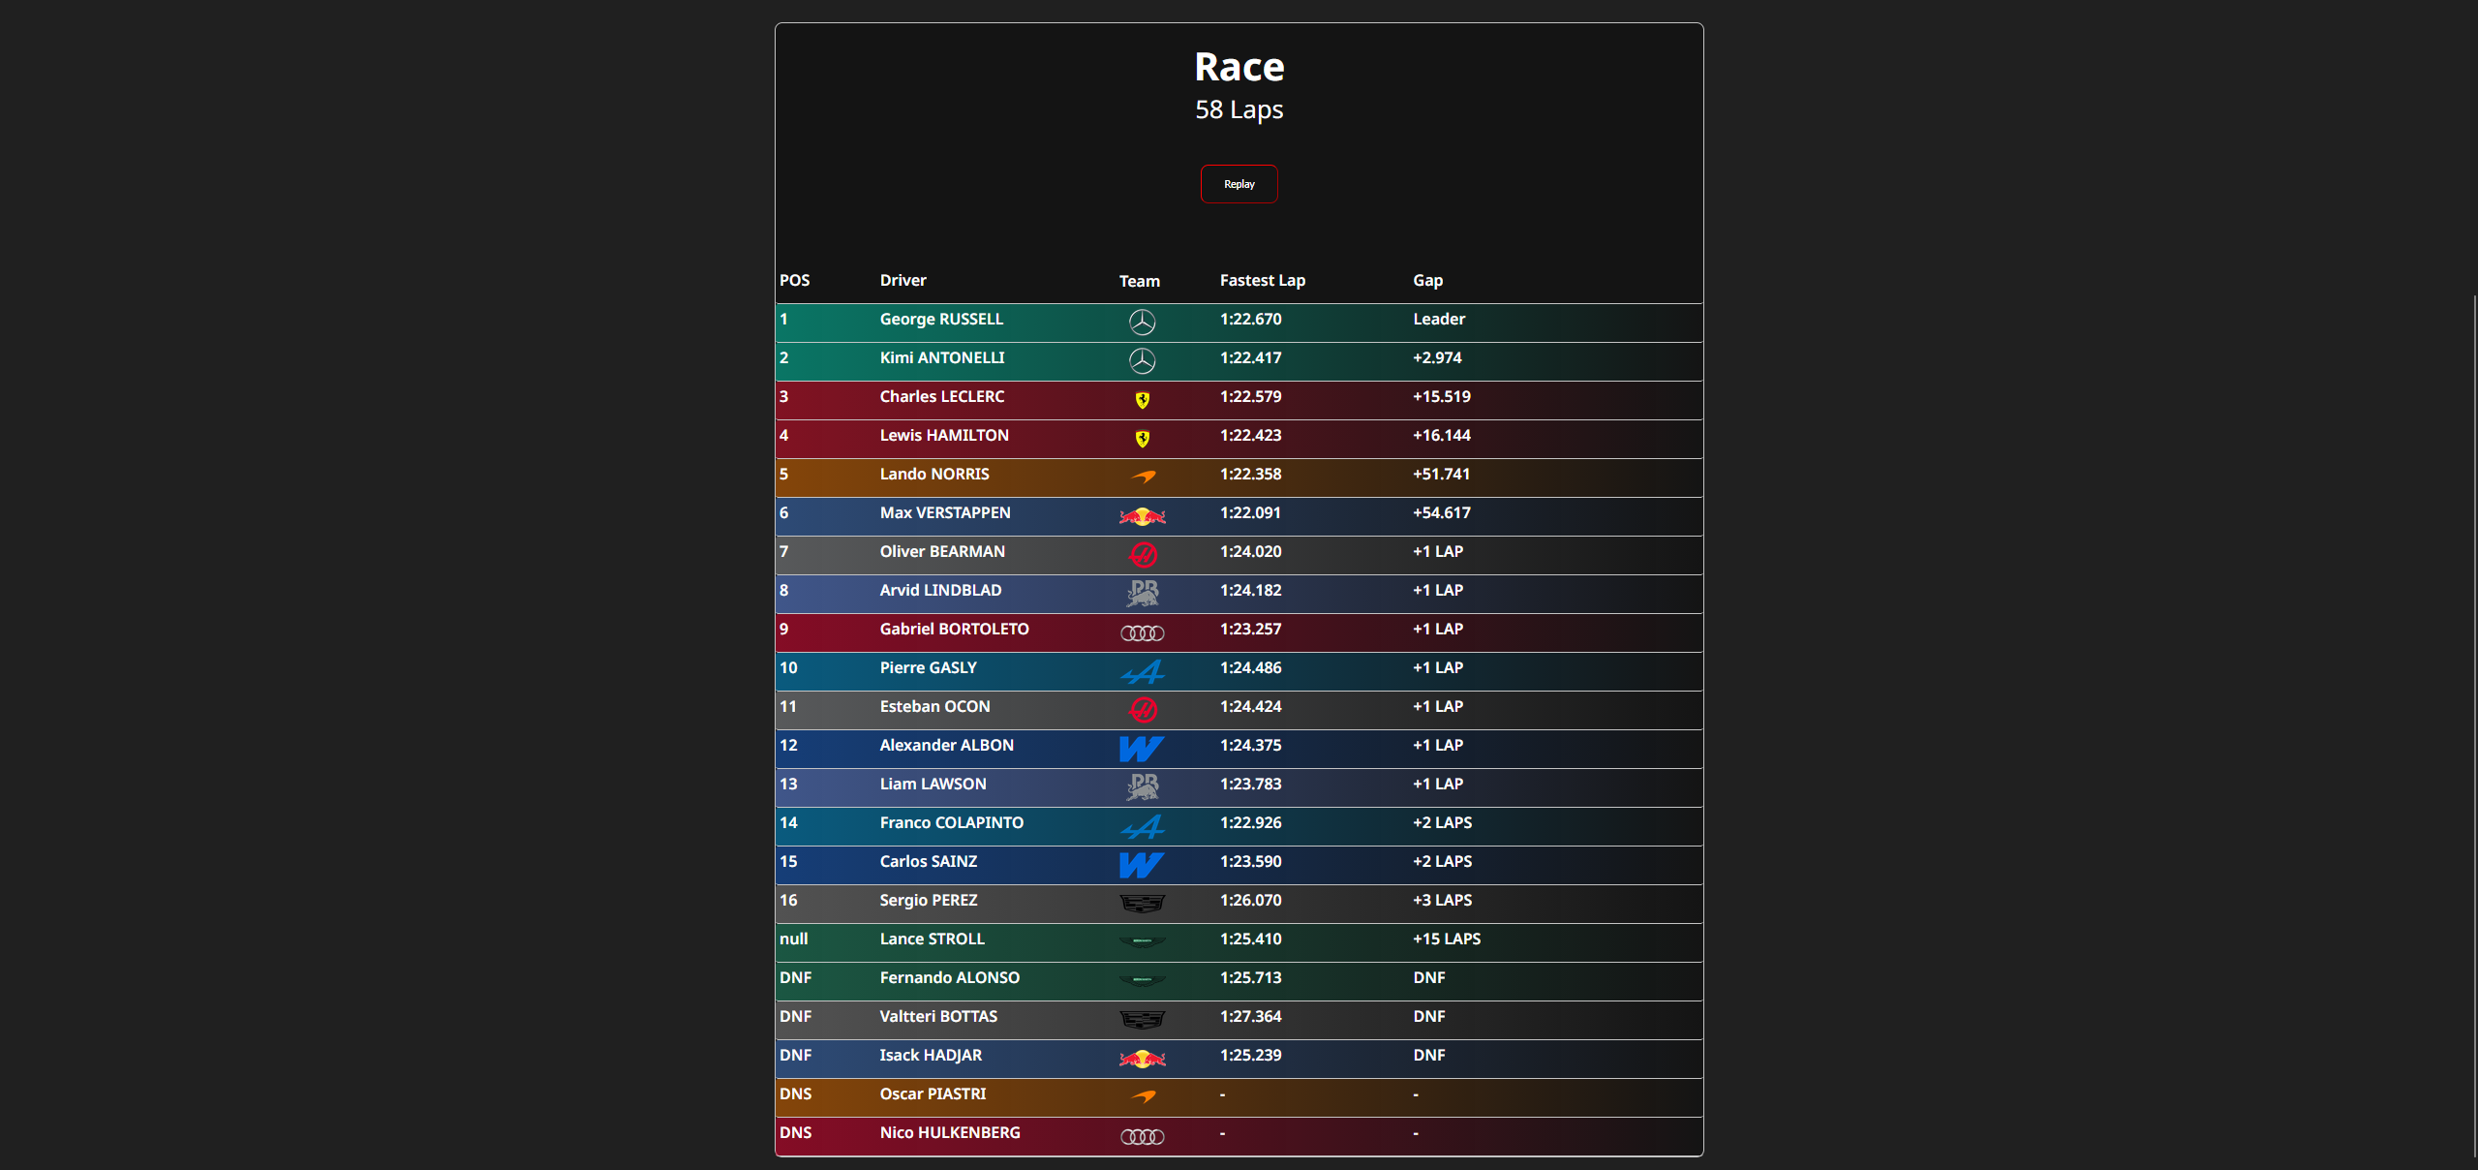
In-depth Results
View full session results
See additional data:
  Fastest Lap
  Gap to Leader
  Number of laps

Slide 11
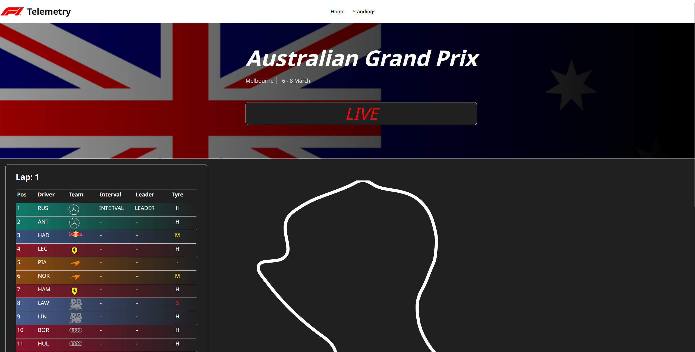
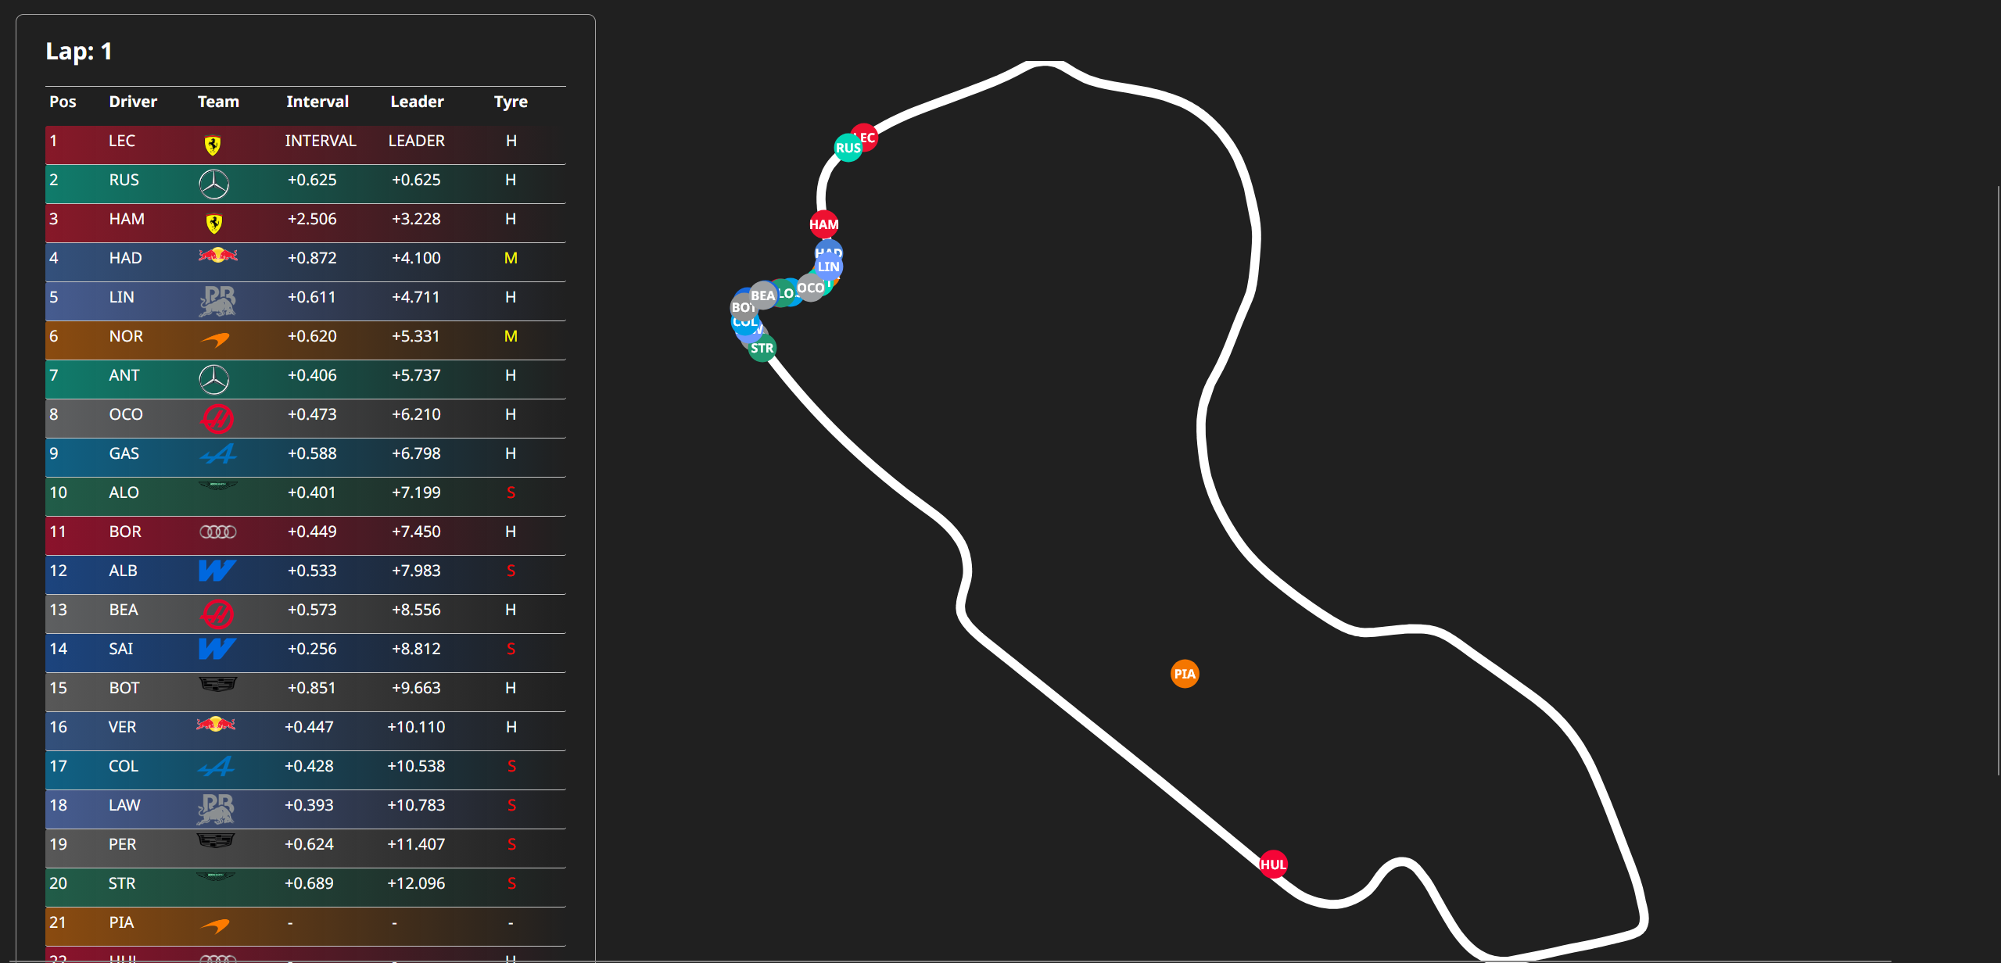
Replay System
Watch full replay of the session:
Timing Tower – Current positions
Mini Map – Current location

Slide 12

Replay Engine
Uses time data to keep all data synced
Updates the UI when there is new data
Makes note where each dataset is at any time
  Allows scrubbing in the future
  Know the sessions state at ANY moment

Slide 13
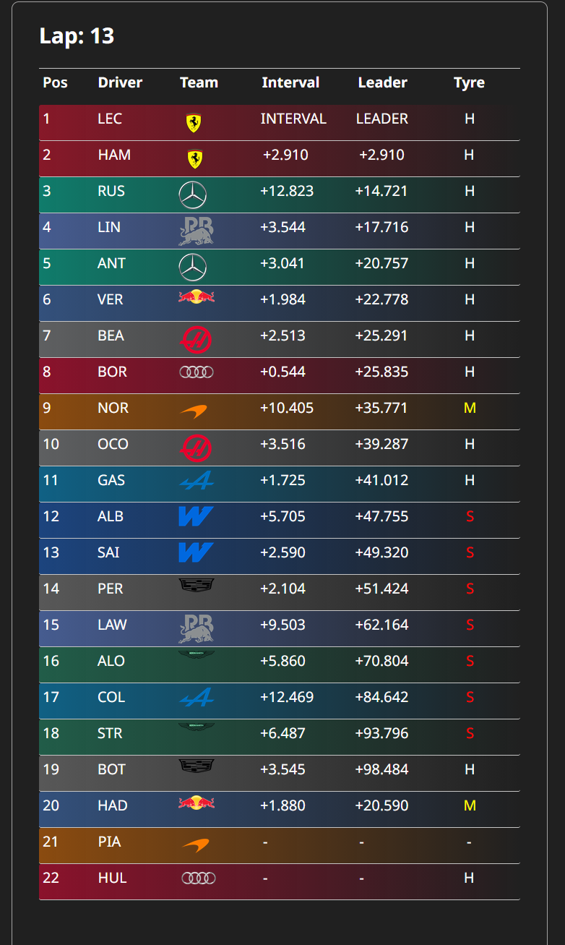
Timing Tower
View each drivers position including:
  Position
  Driver Name
  Interval Gap
  Leader Gap
  Current Tyre Compound
  Current Lap Number

Slide 14
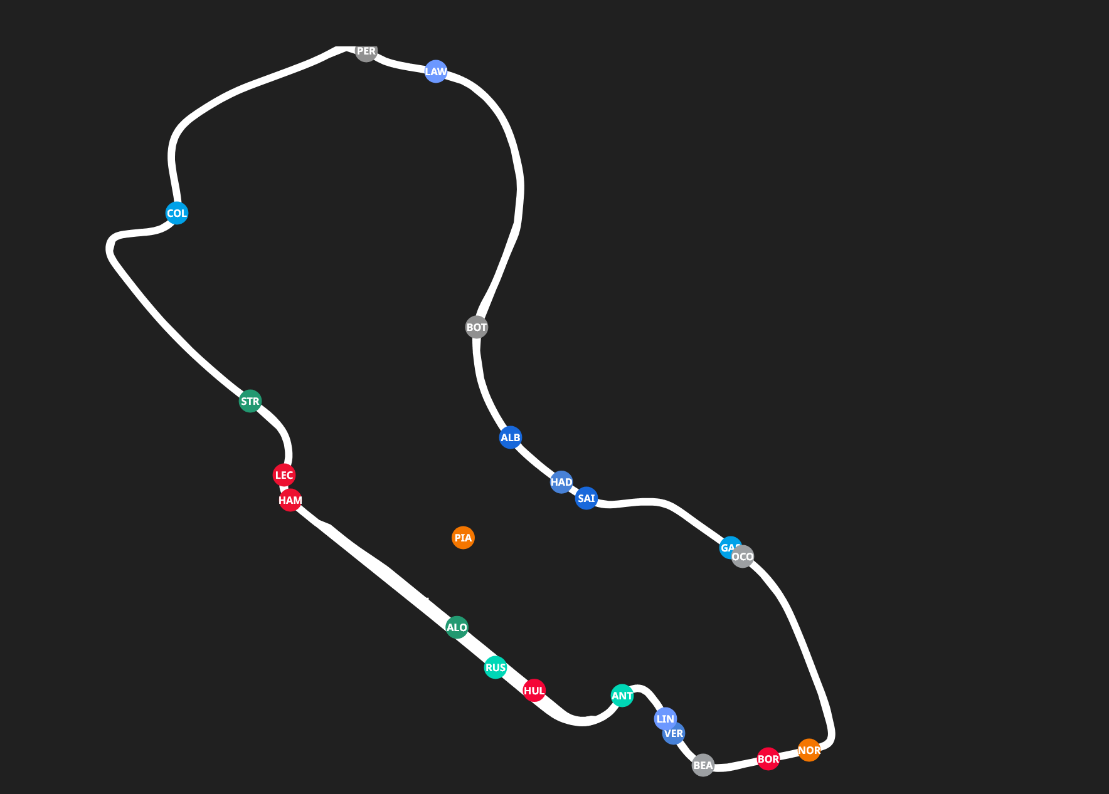
Mini Map
View where each driver is on track
Each driver has:
  A Dot on Map
  Initials in Dot
  Dot in Team Colours

Slide 15
Why does sync matter?
Data is only as relevant as the context it is in, without sync it is a mess of data with no reasoning

Slide 16
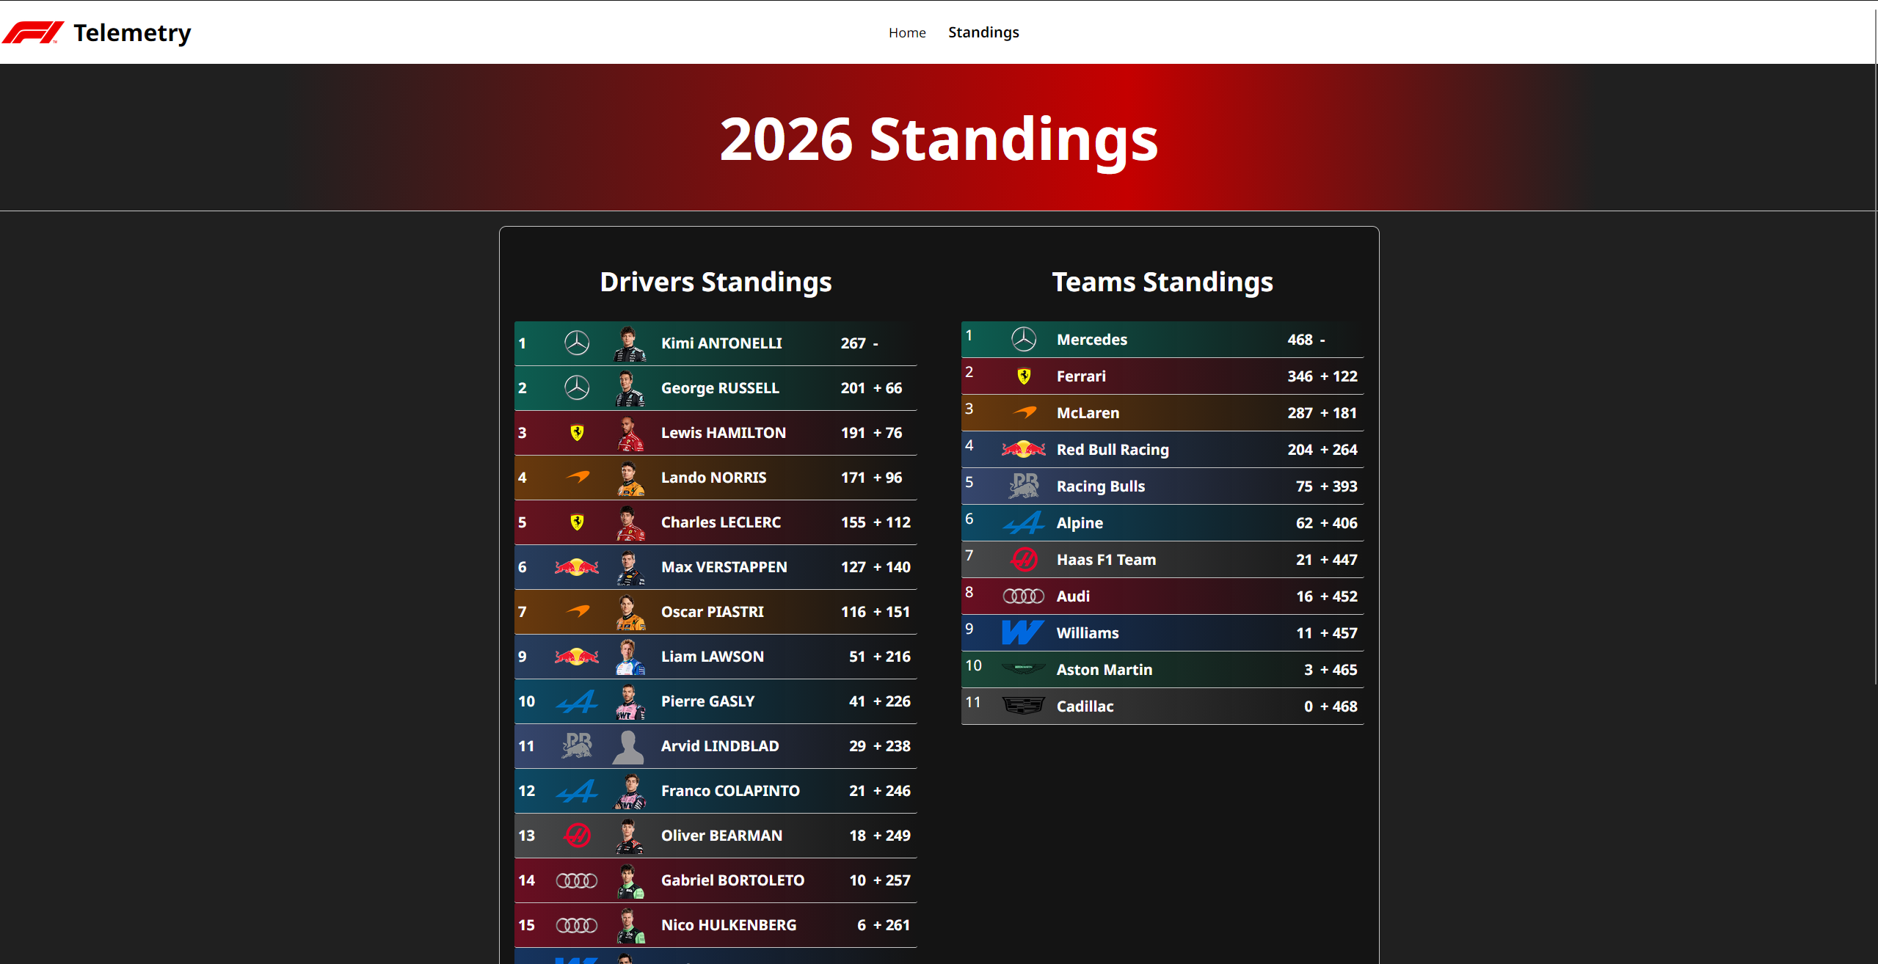
Standings
Shows the current drivers and team standings

Slide 17
Development Challenges
Partially resolved slow API responses
Handling Large API Responses – Location Data
Incorrect/Missing data – Isaack Hadjar missing a race
Constructing a Replay:
  Retrieving all the data
  Processing data in order
  Construct the current state
  Update UI

Slide 18
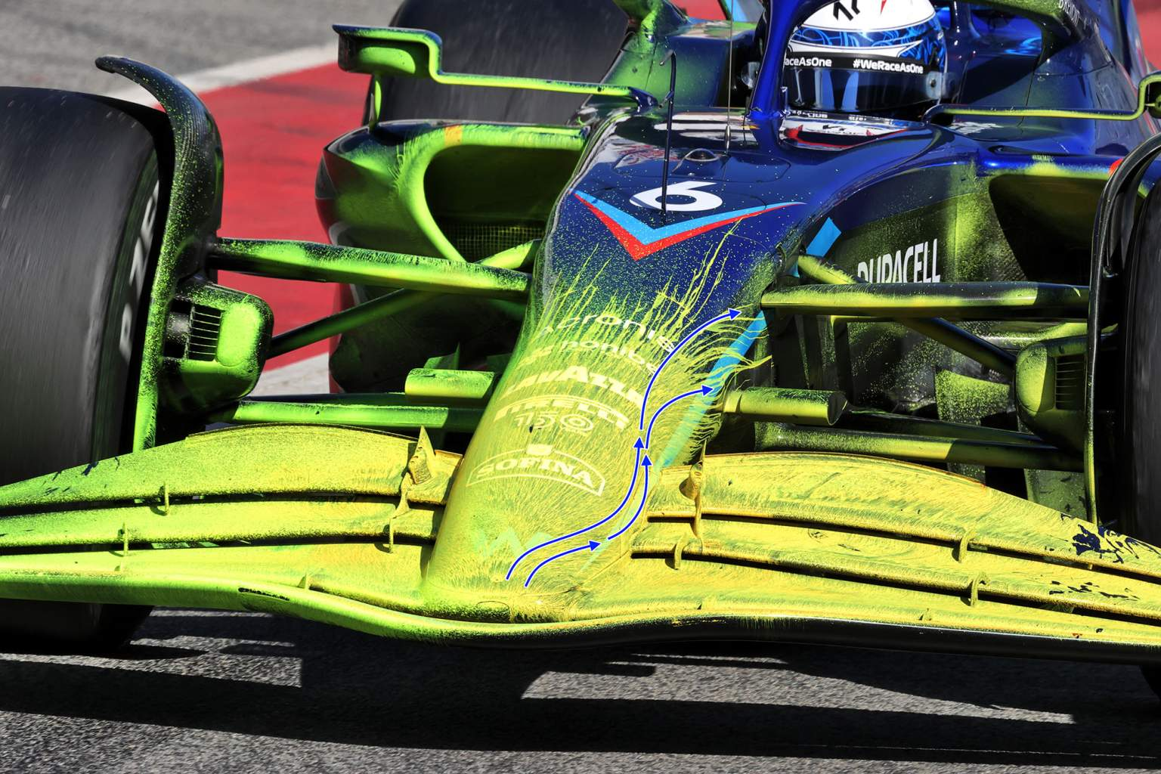
Testing
Iterative Approach
  Test each feature when constructed
  Repeatedly test the site as a whole – Simply use it
Peer Review
  Allows others to use it
  Family and Friends
  Feedback – act on it

Slide 19
What did I achieve?
A functional Formula One data hub
  View any season from 2023 – current
  Select any race weekend
  View results and replay
A working replay system
  Reconstructs a session in real time
  Shows driver movements
  Combines multiple data sets
  Add context to a session
Dynamic, Scalable website
  Designed with the future in mind
  Minimal hard coding
  100% Dynamic
User focused Navigation
  Slowly progress through a weekend:
Season Race Weekend Session Results Replay

Slide 20
Where from here?
Improved Replay
  Better controls
  Scrub through session
  Speed controls + play/pause
Smoother Mini Map
  Generate the map in one go
  Better accuracy, better experience
Session Specific Timing Tower
  Data displayed changes depending on session
  Qualifying/Practice/Race
  Races focus on Gaps
  Qualifying/Practice focus on lap times
Live Sessions
  View sessions as they happen!
  Reason to keep returning
  Same end points
Notes:
Slide 20
Read slide
Improved replay – More controls for the user, freedom, less friction
Smoother Mini Map – Create the map in 1 go, not relying on live data. Created based on fastest lap of each session, less chance for a bad draw.
Timer – Change the information relevant to the session, gaps for race, times for practice and quali
Live sessions – See sessions as they are happening, keeps the user coming back.
Live MQTT uses the same endpoints as REST, only difference is how data is viewed. Similar system can be used.

Slide 21

Any Questions?

